Slide 1

David M. Kroenke and David J. Auer Database Processing: Fundamentals, Design, and Implementation
Chapter Two:
Introduction to Structured Query Language

Slide 2
Chapter Objectives
To understand the use of extracted data sets in business intelligence (BI) systems
To understand the use of ad-hoc queries in business intelligence (BI) systems
To understand the history and significance of Structured Query Language (SQL)
To understand the SQL SELECT/FROM/WHERE framework as the basis for database queries
To create SQL queries to retrieve data from a single table

Slide 3
Chapter Objectives
To create SQL queries that use the SQL SELECT, FROM, WHERE, ORDER BY, GROUP BY, and HAVING clauses
To create SQL queries that use the SQL DISTINCT, AND, OR, NOT, BETWEEN, LIKE, and IN keywords
To create SQL queries that use the SQL built-in functions of SUM, COUNT, MIN, MAX, and AVG with and without the use of a GROUP BY clause

Slide 4
Chapter Objectives
To create SQL queries that retrieve data from a single table but restrict the data based upon data in another table (subquery)
To create SQL queries that retrieve data from multiple tables using an SQL join operation

Slide 5
Business Intelligence (BI) Systems
Business intelligence (BI) systems are information systems that assist managers and other professionals:
Assessment
Analysis
Planning
Control

Slide 6
Ad-Hoc Queries
Ad-hoc queries:
Questions that can be answered using database data
Example: “How many customers in Portland, Oregon, bought our green baseball cap?”
Created by the user as needed, instead of programmed into an application
Common in business

Slide 7
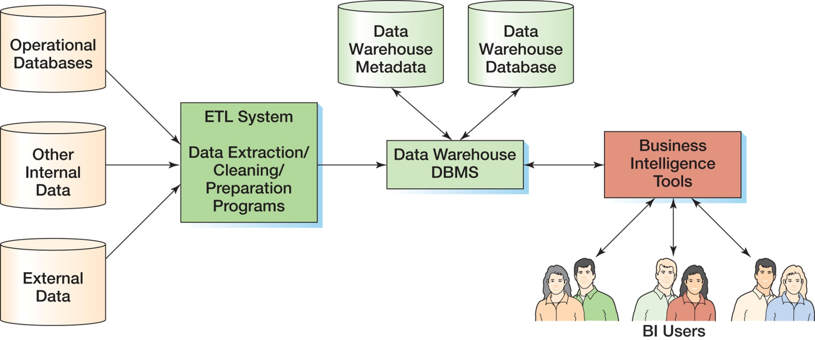
Components of a Data Warehouse

Slide 8
Structured Query Language
Structured Query Language (SQL) was developed by the IBM Corporation in the late 1970’s.
SQL was endorsed as a U.S. national standard by the American National Standards Institute (ANSI) in 1992 [SQL-92].
Newer versions exist, and they incorporate XML and some object-oriented concepts.

Slide 9
SQL As a Data Sublanguage
SQL is not a full featured programming language.
C, C#, Java
SQL is a data sublanguage for creating and processing database data and metadata.
SQL is ubiquitous in enterprise-class DBMS products.
SQL programming is a critical skill.

Slide 10
SQL DDL, DML, and SQL/PSM
SQL statements can be divided into three categories:
Data definition language (DDL) statements
Used for creating tables, relationships, and other structures
Covered in Chapter 7
Data manipulation language (DML) statements
Used for queries and data modification
Covered in this chapter (Chapter 2)

Slide 11
SQL DDL, DML, and SQL/PSM
SQL/Persistent Stored Modules (SQL/PSM) statements
Add procedural programming capabilities
Variables
Control-of-flow statements
Covered in Chapters:
7 (general introduction)
10A (SQL Server 2012)
10B (Oracle Database 11g Release 2)
10C (MySQL 5.6)

Slide 12
SQL TCL
Transaction control language (TCL) statements
Used to mark transaction boundaries and control transaction behavior
Covered in Chapters:
9 (general introduction)
10A (SQL Server 2012)
10B (Oracle Database 11g Release 2)
10C (MySQL 5.6)

Slide 13
SQL DCL
Data control language (DCL) statements
Used to grant (or revoke) database permissions to (from) users and groups
Covered in Chapters:
9 (general introduction)
10A (SQL Server 2012)
10B (Oracle Database 11g Release 2)
10C (MySQL 5.6)

Slide 14
Cape Codd Outdoor Sports
Cape Codd Outdoor Sports is a fictitious company based on an actual outdoor retail equipment vendor.
Cape Codd Outdoor Sports:
Has 15 retail stores in the United States and Canada.
Has an online Internet store.
Has a (postal) mail order department.
All retail sales are recorded in an Oracle Database 11g database.

Slide 15
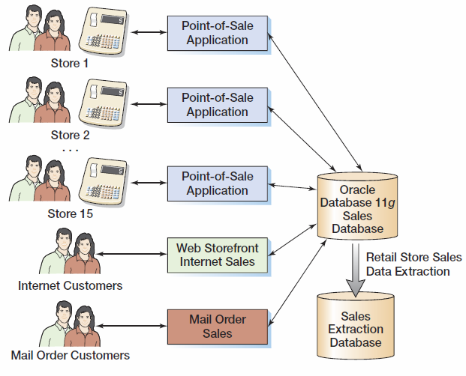
Cape Codd Retail Sales Structure

Slide 16
Cape Codd Retail Sales Data Extraction
The Cape Codd marketing department needs an analysis of in-store sales.
The entire database is not needed for this, only an extraction of retail sales data.
The data is extracted by the IS department from the operational database into a separate, off-line database for use by the marketing department.
Three tables are used: RETAIL_ORDER, ORDER_ITEM, and SKU_DATA (SKU = Stock Keeping Unit).
The extracted data is converted as necessary:
Into a different DBMS—Microsoft SQL Server
Into different columns—OrderDate becomes OrderMonth and OrderYear.

Slide 17
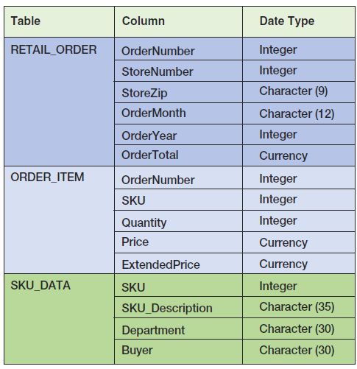
Extracted Retail Sales Data Format

Slide 18
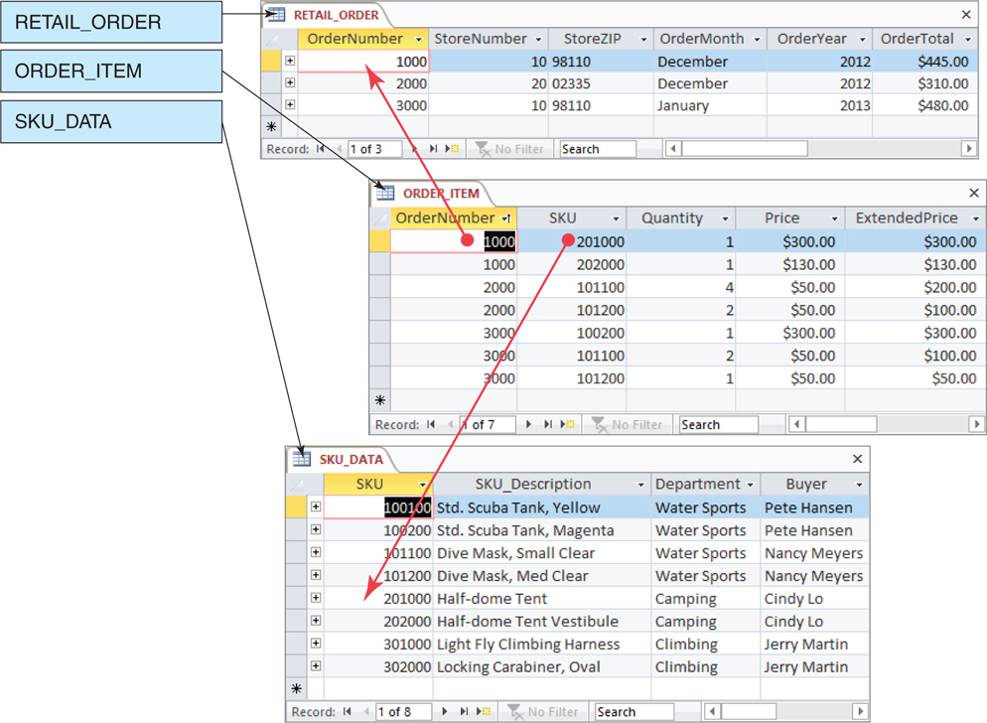
Retail Sales Extract Tables [in Microsoft Access 2010]

Slide 19
The SQL SELECT Statement
The fundamental framework for an SQL query is the SQL SELECT statement.
SELECT {ColumnName(s)}
FROM {TableName(s)}
WHERE {Condition(s)}
All SQL statements end with a semi-colon (;).

Slide 20
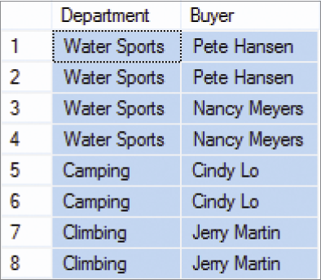
Specific Columns on One Table
SELECT Department, Buyer
FROM SKU_DATA;

Slide 21
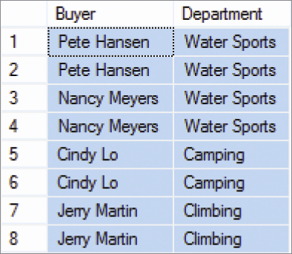
Specifying Column Order
SELECT Buyer, Department
FROM SKU_DATA;

Slide 22
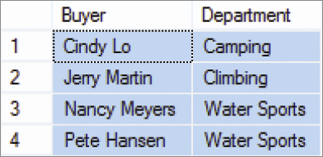
The DISTINCT Keyword
SELECT DISTINCT Buyer, Department
FROM SKU_DATA;

Slide 23
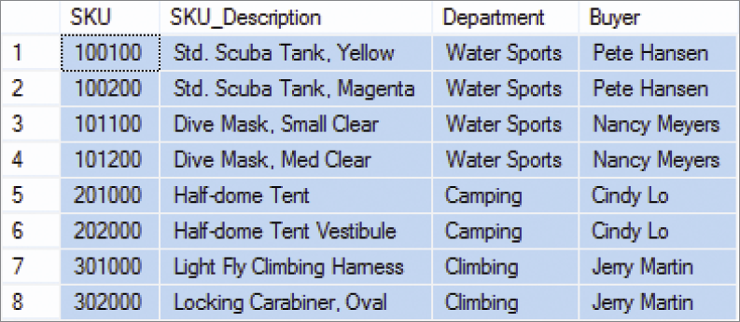
Selecting All Columns: The Asterisk (*) Wildcard Character
SELECT *
FROM SKU_DATA;

Slide 24
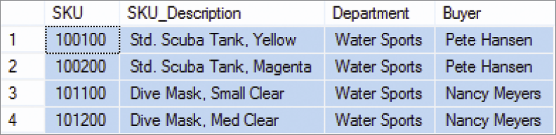
Specific Rows from One Table
SELECT *
FROM SKU_DATA
WHERE Department = 'Water Sports';
NOTE: SQL wants a plain ASCII single quote: ' NOT ‘ !

Slide 25
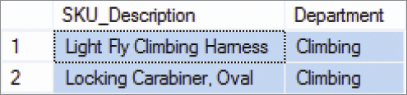
Specific Columns and Rows from One Table
SELECT SKU_Description, Buyer
FROM SKU_DATA
WHERE Department = 'Climbing';

Slide 26
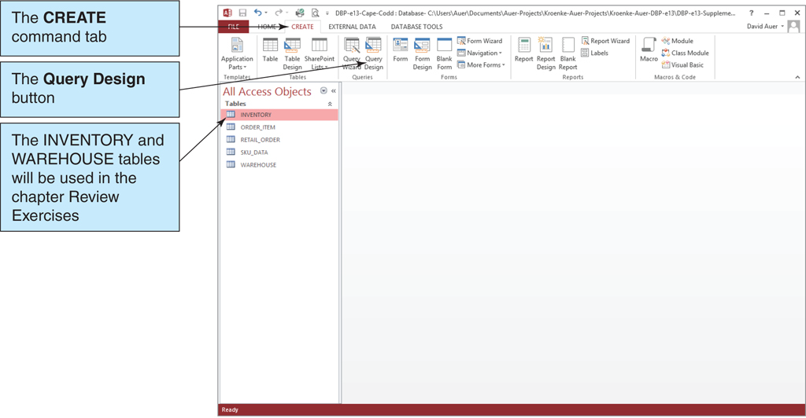
Using Microsoft Access I

Slide 27
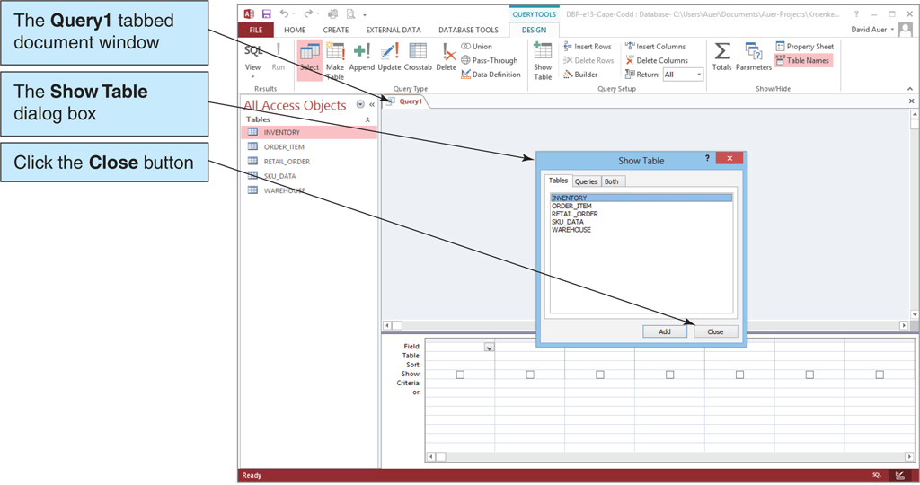
Using Microsoft Access II

Slide 28
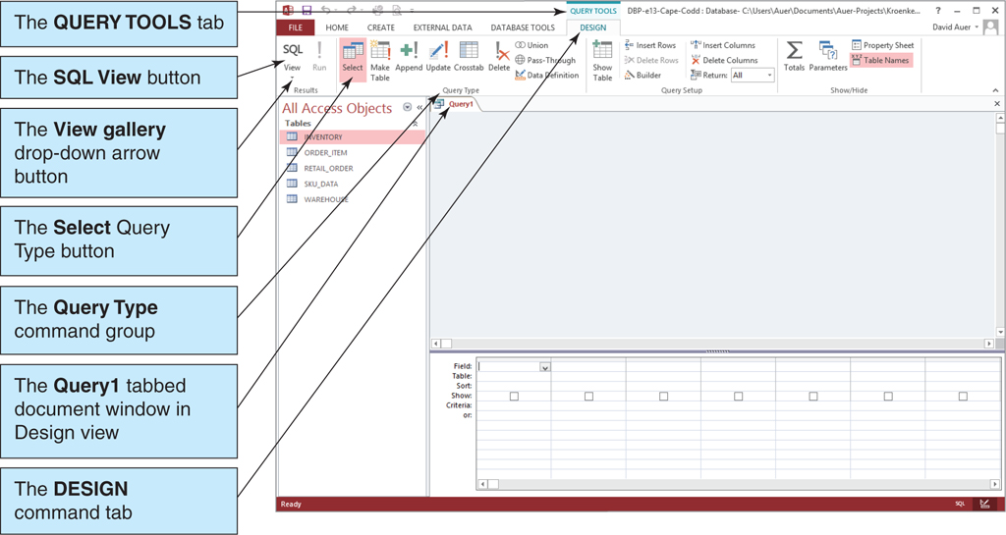
Using Microsoft Access III

Slide 29
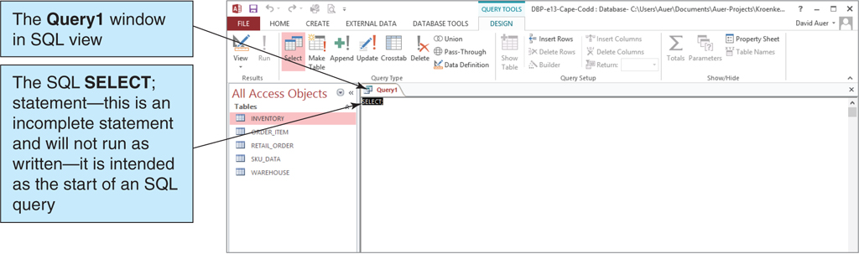
Using Microsoft Access IV

Slide 30
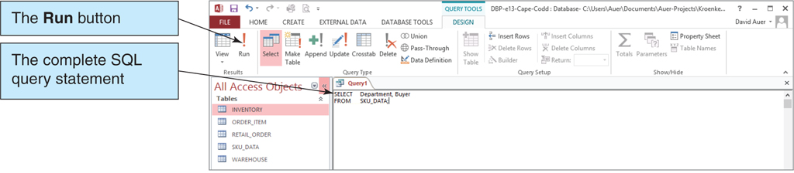
Using Microsoft Access V

Slide 31
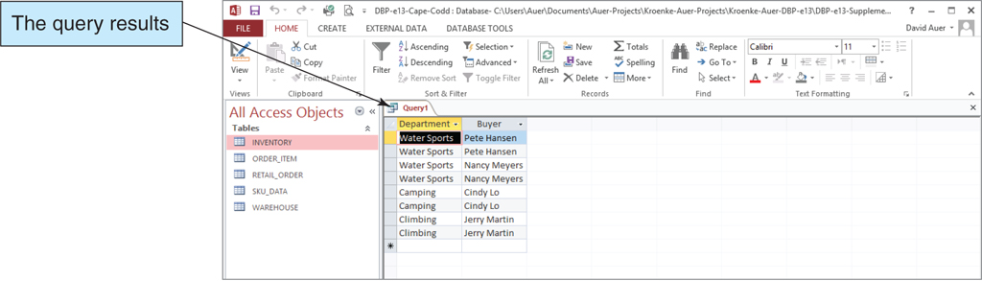
Using Microsoft Access—Results

Slide 32
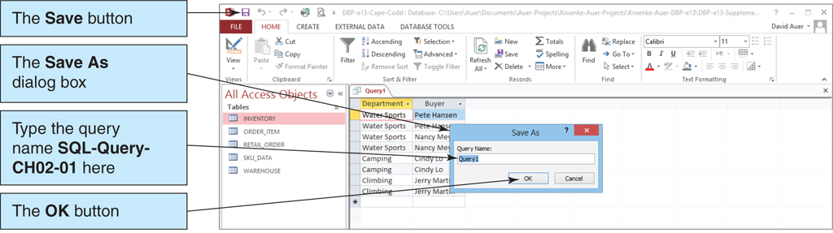
Using Microsoft Access Saving the Query

Slide 33
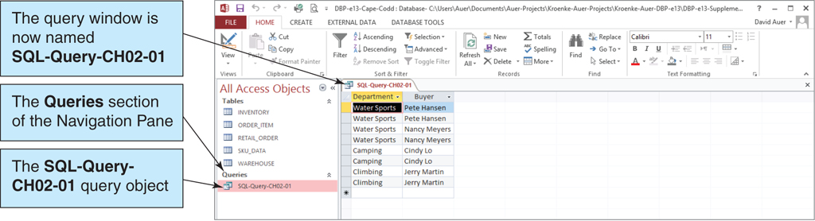
Using Microsoft Access The Named and Saved Query

Slide 34
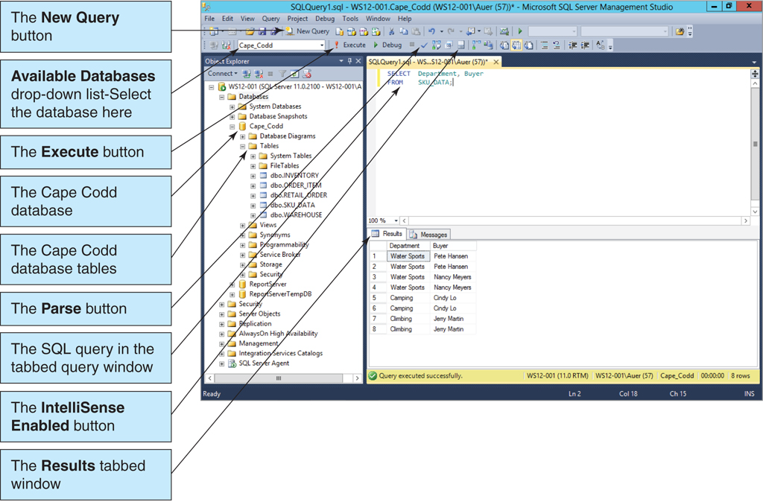
Using Microsoft SQL Server 2012 The Microsoft SQL Server Management Studio I

Slide 35
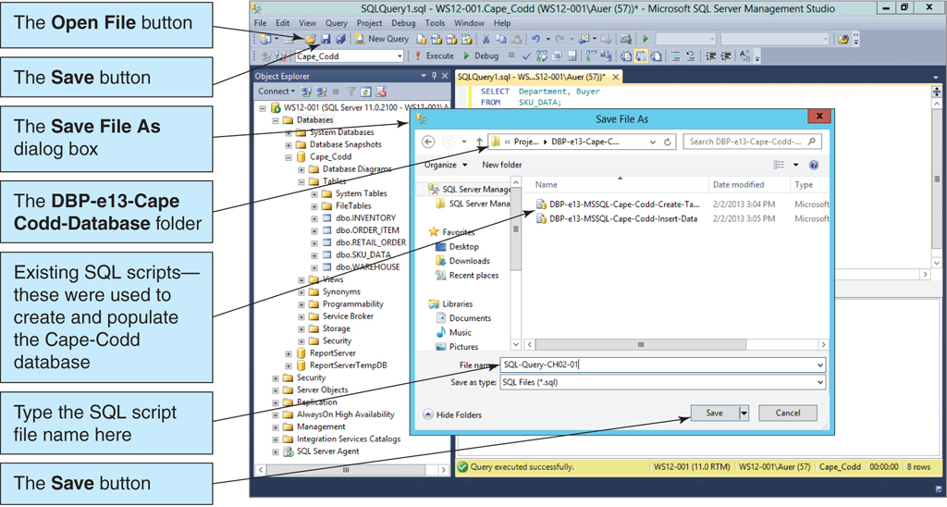
Using Microsoft SQL Server 2012 The Microsoft SQL Server Management Studio II

Slide 36
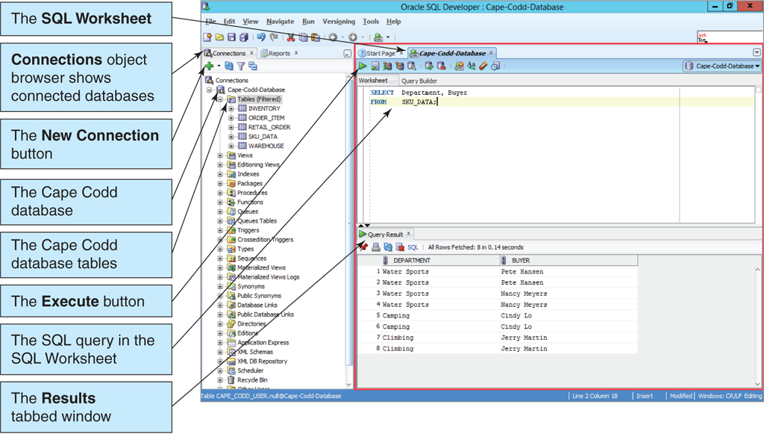
Using Oracle Database 11g Release 2 SQL Developer I

Slide 37
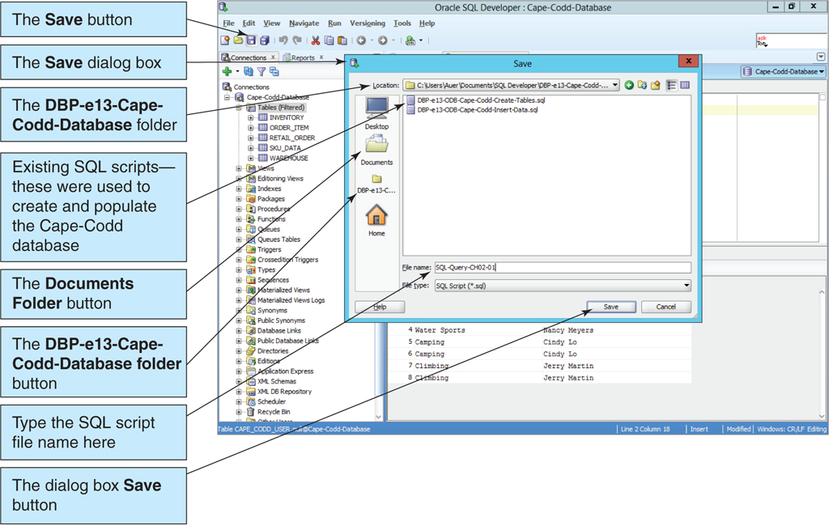
Using Oracle Database 11g Release 2 SQL Developer II

Slide 38
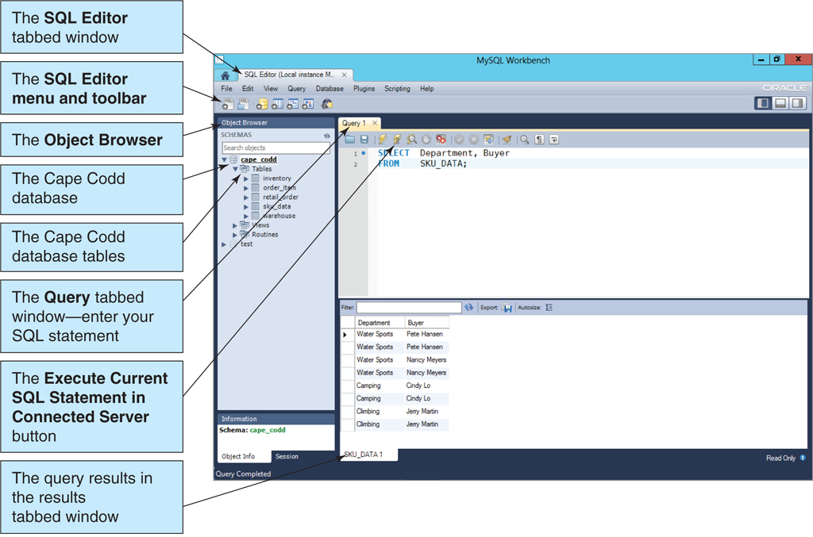
Using MySQL 5.6 MySQL Workbench I

Slide 39
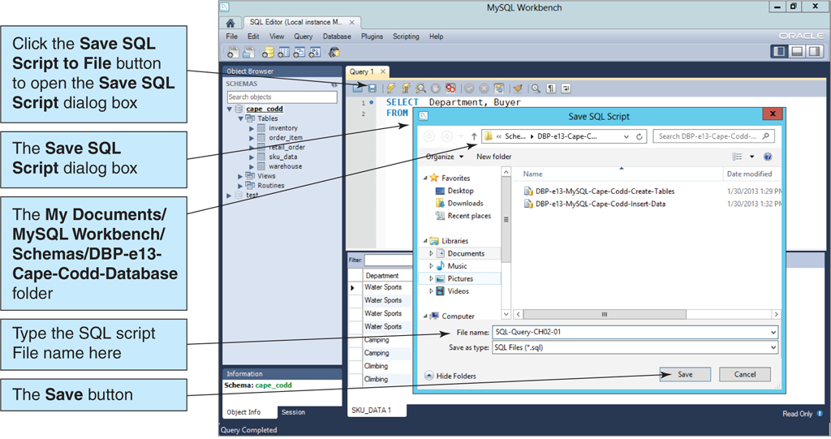
Using MySQL 5.6 MySQL Workbench II

Slide 40
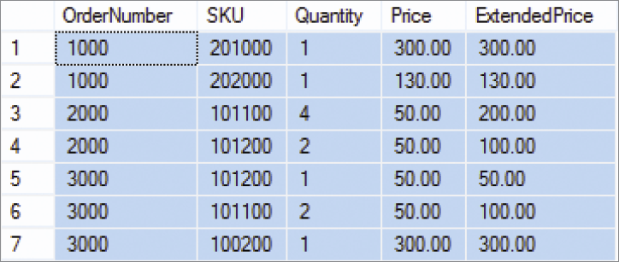
Sorting the Results—ORDER BY
SELECT *
FROM ORDER_ITEM
ORDER BY OrderNumber, Price;

Slide 41
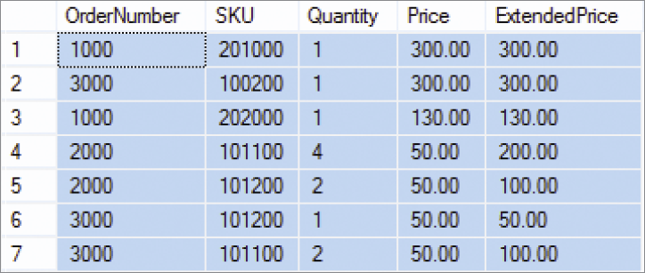
Sort Order: Ascending and Descending
SELECT *
FROM ORDER_ITEM
ORDER BY Price DESC, OrderNumber ASC;
NOTE: The default sort order is ASC—does not have to be specified.

Slide 42
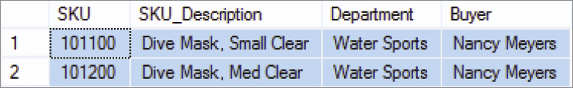
WHERE Clause Options—AND
SELECT *
FROM SKU_DATA
WHERE Department = 'Water Sports'
AND Buyer = 'Nancy Meyers';

Slide 43
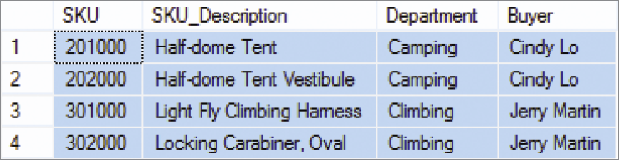
WHERE Clause Options—OR
SELECT *
FROM SKU_DATA
WHERE Department = 'Camping'
OR Department = 'Climbing';

Slide 44
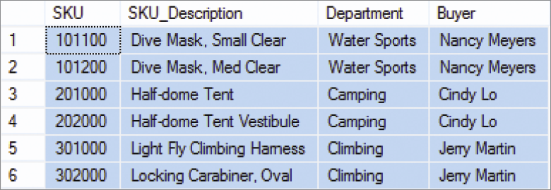
WHERE Clause Options—IN
SELECT *
FROM SKU_DATA
WHERE Buyer IN ('Nancy Meyers',
'Cindy Lo', 'Jerry Martin');

Slide 45
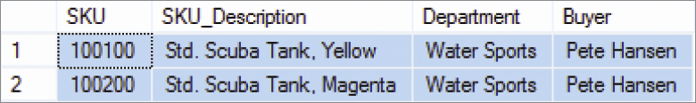
WHERE Clause Options—NOT IN
SELECT *
FROM SKU_DATA
WHERE Buyer NOT IN ('Nancy Meyers',
'Cindy Lo', 'Jerry Martin');

Slide 46
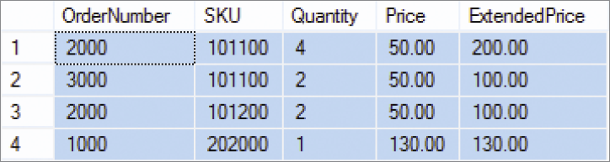
WHERE Clause Options—Ranges with BETWEEN
SELECT *
FROM ORDER_ITEM
WHERE ExtendedPrice
BETWEEN 100 AND 200;

Slide 47
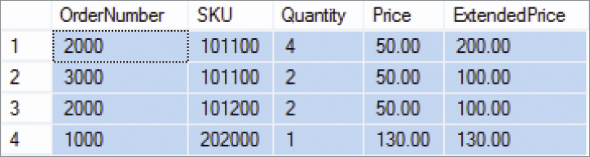
WHERE Clause Options—Ranges with Math Symbols
SELECT *
FROM ORDER_ITEM
WHERE ExtendedPrice >= 100
AND ExtendedPrice <= 200;

Slide 48
WHERE Clause Options— LIKE and Wildcards I
The SQL keyword LIKE can be combined with wildcard symbols:
SQL 92 Standard (SQL Server, MySQL, etc.):
_ = exactly one character
% = any set of one or more characters
Microsoft Access (based on MS DOS)
? = exactly one character
* = any set of one or more characters

Slide 49
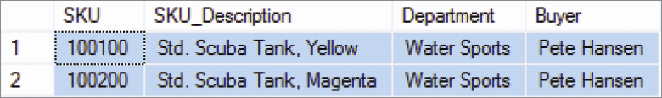
WHERE Clause Options— LIKE and Wildcards II
SELECT *
FROM SKU_DATA
WHERE Buyer LIKE 'Pete%';

Slide 50
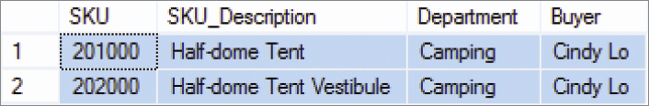
WHERE Clause Options— LIKE and Wildcards III
SELECT *
FROM SKU_DATA
WHERE Buyer LIKE '%Tent%';

Slide 51
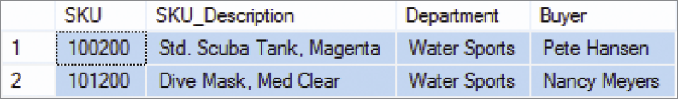
WHERE Clause Options— LIKE and Wildcards IV
SELECT *
FROM SKU_DATA
WHERE SKU LIKE '%2__';

Slide 52
SQL Built-In Functions I
There are five SQL built-in functions:
COUNT
SUM
AVG
MIN
MAX

Slide 53
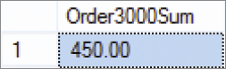
SQL Built-In Functions II
SELECT SUM(ExtendedPrice)
AS Order3000Sum
FROM ORDER_ITEM
WHERE OrderNumber = 3000;

Slide 54
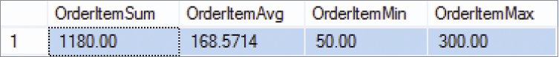
SQL Built-In Functions III
SELECT SUM(ExtendedPrice) AS OrderItemSum,
AVG(ExtendedPrice) AS OrderItemAvg,
MIN(ExtendedPrice) AS OrderItemMin,
MAX(ExtendedPrice) AS OrderItemMax
FROM ORDER_ITEM;

Slide 55
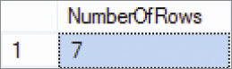
SQL Built-In Functions IV
SELECT COUNT(*) AS NumberOfRows
FROM ORDER_ITEM;

Slide 56
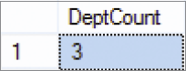
SQL Built-In Functions V
SELECT COUNT
(DISTINCT Department)
AS DeptCount
FROM SKU_DATA;

Slide 57
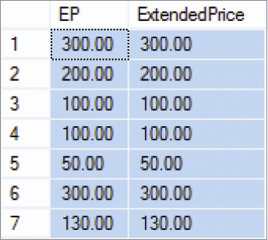
Arithmetic in SELECT Statements
SELECT Quantity * Price AS EP,
ExtendedPrice
FROM ORDER_ITEM;

Slide 58
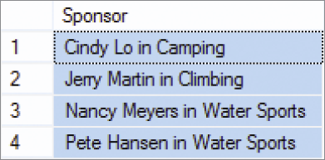
String Functions in SELECT Statements
SELECT DISTINCT RTRIM (Buyer)
+ ' in ' + RTRIM (Department) AS Sponsor
FROM SKU_DATA;
NOTE: This SQL statement uses SQL Server 2012 syntax—other DBMS products use different concatenation and character string operators.

Slide 59
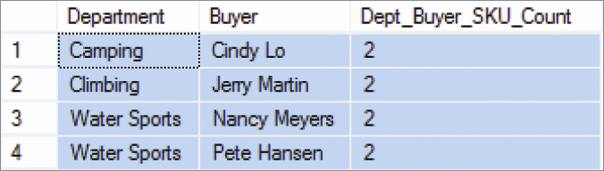
The SQL Keyword GROUP BY I
SELECT Department, Buyer,
COUNT(*) AS
Dept_Buyer_SKU_Count
FROM SKU_DATA
GROUP BY Department, Buyer;

Slide 60
The SQL Keyword GROUP BY II
In general, place WHERE before GROUP BY. Some DBMS products do not require that placement; but to be safe, always put WHERE before GROUP BY.
The HAVING operator restricts the groups that are presented in the result.
There is an ambiguity in statements that include both WHERE and HAVING clauses. The results can vary, so to eliminate this ambiguity SQL always applies WHERE before HAVING.

Slide 61
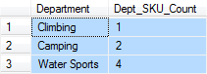
The SQL Keyword GROUP BY III
SELECT Department, COUNT(*) AS
Dept_SKU_Count
FROM SKU_DATA
WHERE SKU <> 302000
GROUP BY Department
ORDER BY Dept_SKU_Count;

Slide 62
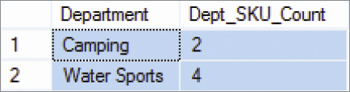
The SQL Keyword GROUP BY IV
SELECT Department, COUNT(*) AS
Dept_SKU_Count
FROM SKU_DATA
WHERE SKU <> 302000
GROUP BY Department
HAVING COUNT (*) > 1
ORDER BY Dept_SKU_Count;

Slide 63
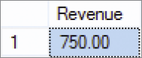
Querying Multiple Tables: Subqueries I
SELECT SUM (ExtendedPrice) AS Revenue
FROM ORDER_ITEM
WHERE SKU IN
(SELECT SKU
FROM SKU_DATA
WHERE Department = 'Water Sports');
Note: The second SELECT statement is a subquery.

Slide 64
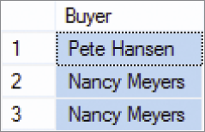
Querying Multiple Tables: Subqueries II
SELECT Buyer
FROM SKU_DATA
WHERE SKU IN
(SELECT SKU
FROM ORDER_ITEM
WHERE OrderNumber IN
(SELECT OrderNumber
FROM RETAIL_ORDER
WHERE OrderMonth = 'January'
AND OrderYear = 2013));

Slide 65
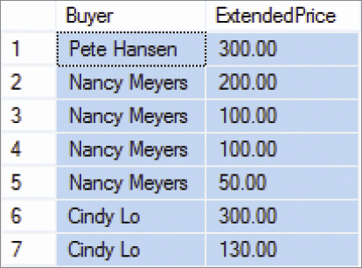
Querying Multiple Tables: Joins I
SELECT Buyer, ExtendedPrice
FROM SKU_DATA, ORDER_ITEM
WHERE SKU_DATA.SKU = ORDER_ITEM.SKU;

Slide 66
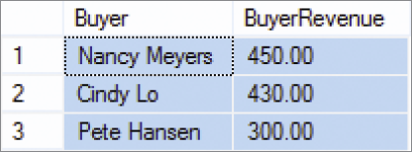
Querying Multiple Tables: Joins II
SELECT Buyer, SUM(ExtendedPrice)
AS BuyerRevenue
FROM SKU_DATA, ORDER_ITEM
WHERE SKU_DATA.SKU = ORDER_ITEM.SKU
GROUP BY Buyer
ORDER BY BuyerRevenue DESC;

Slide 67
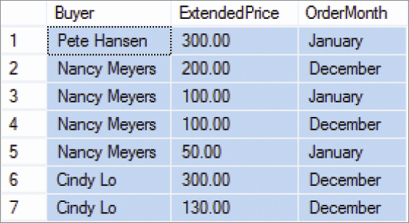
Querying Multiple Tables: Joins III
SELECT Buyer, ExtendedPrice, OrderMonth
FROM SKU_DATA, ORDER_ITEM, RETAIL_ORDER
WHERE SKU_DATA.SKU = ORDER_ITEM.SKU
AND ORDER_ITEM.OrderNumber =
RETAIL_ORDER.OrderNumber;

Slide 68
JOIN ON Syntax
SELECT RETAIL_ORDER.OrderNumber, StoreNumber, OrderYear,
ORDER_ITEM.SKU, SKU_Description, Department
FROM RETAIL_ORDER JOIN ORDER_ITEM
ON RETAIL_ORDER.OrderNumber=ORDER_ITEM.OrderNumber
JOIN SKU_DATA
ON ORDER_ITEM.SKU=SKU_DATA.SKU
WHERE OrderYear = '2012'
ORDER BY RETAIL_ORDER.OrderNumber, ORDER_ITEM.SKU;

Slide 69
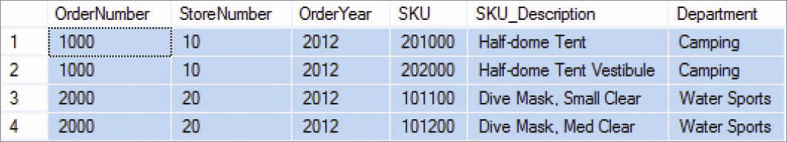
JOIN ON Syntax Results

Slide 70

OUTER JOINS I

Slide 71

OUTER JOINS II

Slide 72

OUTER JOINS III

Slide 73

OUTER JOINS IV

Slide 74
Subqueries versus Joins
Subqueries and joins both process multiple tables.
A subquery can only be used to retrieve data from the top table.
A join can be used to obtain data from any number of tables, including the “top table” of the subquery.
In Chapter 7, we will study the correlated subquery. That kind of subquery can do work that is not possible with joins.

Slide 75
David Kroenke and David Auer Database Processing Fundamentals, Design, and Implementation (13th Edition)
End of Presentation:
Chapter Two

Slide 76

All rights reserved. No part of this publication may be reproduced, stored in a retrieval system, or transmitted, in any form or by any means, electronic, mechanical, photocopying, recording, or otherwise, without the prior written permission of the publisher. Printed in the United States of America.

